Slide 1

LPG Gas Leakage Detection System with Automatic On/Off Regulator
A Smart IoT-Based Safety System

Slide 2
Introduction
LPG (Liquefied Petroleum Gas) is widely used in homes and industries but is highly flammable, making leaks dangerous. Traditional detection methods rely on human intervention, which can be slow and ineffective in emergencies.
This project aims to automate gas leak detection using an MQ-6 sensor and Arduino. When a leak is detected, the system triggers an alarm, turns on an exhaust fan, and shuts off the gas supply using a solenoid valve, ensuring a quick and safe response.

Slide 3
Problem Statement
LPG leaks can cause fire hazards, explosions, and poisoning.
Traditional gas detection methods lack automation for gas cut-off.
Need for a smart, real-time, and automatic gas regulation system.

Slide 4
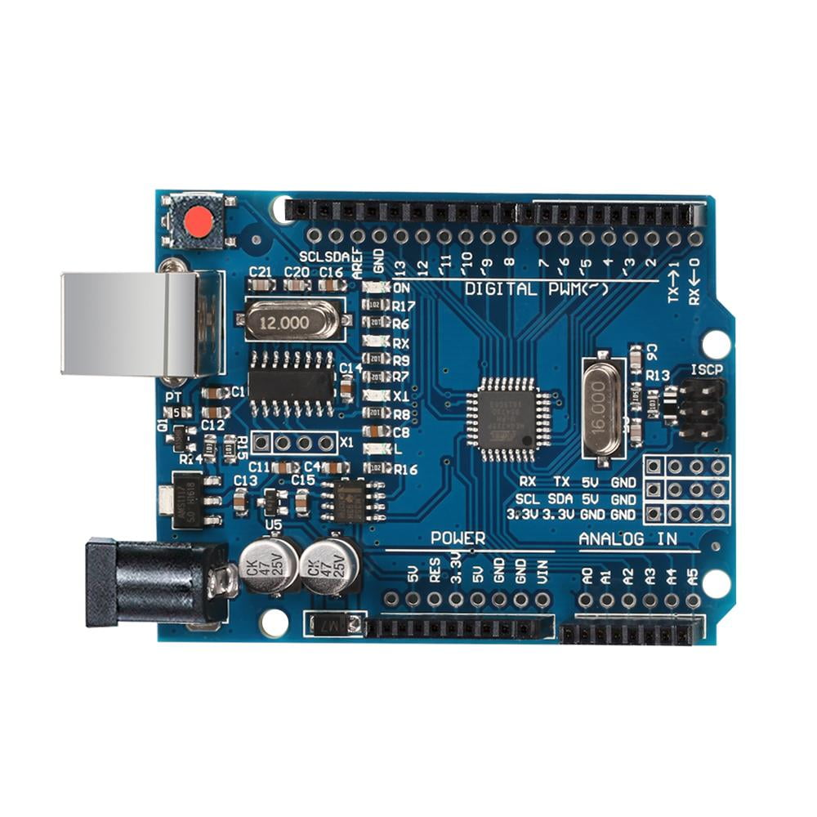

Hardware Components
Arduino Uno
MQ-6 Gas Senso
The best board to get started with electronics and coding
Monitoring and alerting us when potentially harmful gas levels are reached

Slide 5

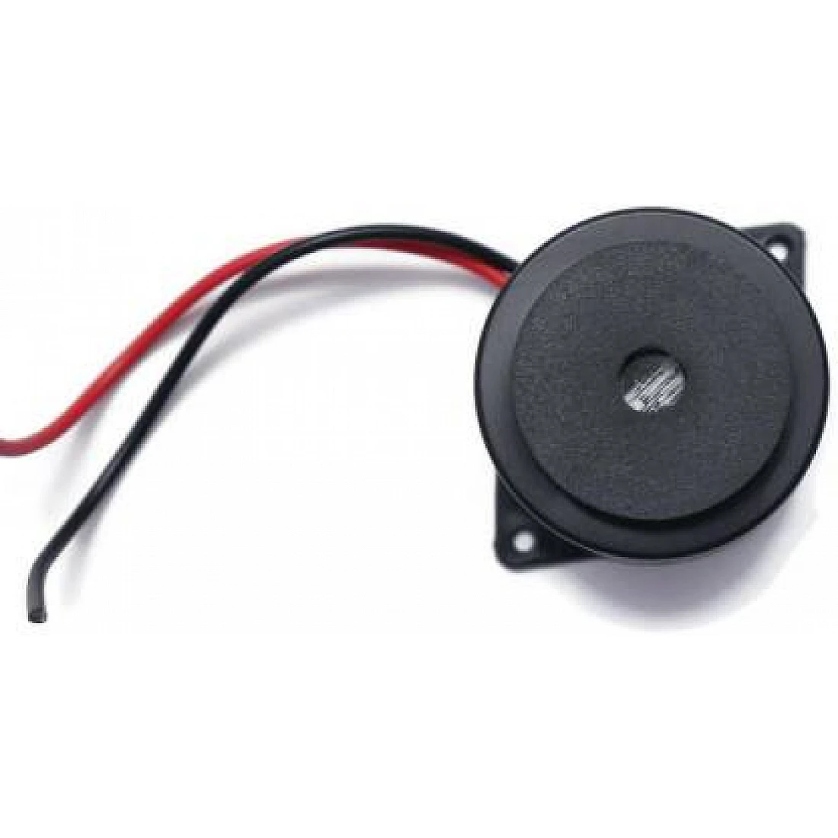
Hardware Components
Gas regulator
Buzzer
Maintains a defined pressure of a system by cutting off the flow of a gas or liquid when it reaches a set pressure
A basic audio device that generates a sound from an incoming electrical signal

Slide 6


Hardware Components
Exhaust Fan
Servo Motor
To expel stale air, moisture, and unwanted odours from a specific area, especially in homes
produces torque and velocity based on the supplied current and voltage

Slide 7
Software & Programming
Arduino IDE used for codinG

Slide 8
Key Features of Code
Reads sensor data from MQ-6.
Triggers alarm & exhaust fan when gas is detected.
Activates relay to shut solenoid valve.
Turns off gas regulator via servo motor.
Resets system when gas level is safe.

Slide 9
Future Scope
Mobile App Integration (IoT-based control).
AI-based predictive maintenance to detect sensor failures.
Wireless Gas Sensors for larger areas.

Slide 10


Slide 11

SRI PRASATH S
II Msc (Information Technology)

